Slide 1
Capstone Project
Bike Sharing Demand Prediction
By Shivam Tiwari and Tapomay Sahoo

Slide 2
Points for discussion
Know the project
EDA
Feature Engineering & Data pre-processing
Model Building
Conclusion

Slide 3
Know The Project

Slide 4
Problem Statement
The dataset is of Seoul's public bike rental service called "Ttareungi," also known as Seoul Bike. It has become one of the capital city's most popular public transport systems by being used more than 100 million times since the service was launched in December 2015, as reported in early 2022. The popularity however has posed the challenge of keeping the bikes available as and when the demand for them rises.
So our goal is to identify the variables that have a say in the demand of the bikes and then build a model that helps predict the demands as and when the climatic conditions change.

Slide 5
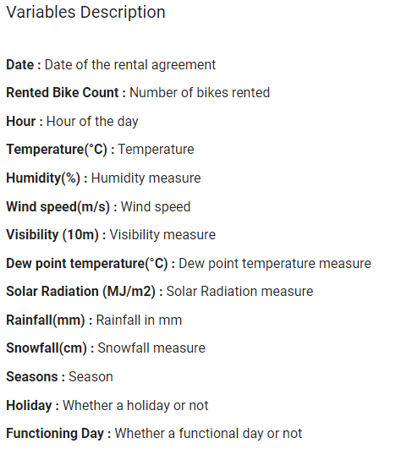
Data summary
From the first looks, the dataset looks a lot cleaner than most ones we usually work with. It has no null values and no duplicate values.
We have 8760 data points, 13 independent variables and one dependent variable, Rented Bike Count.
Most of the variables are numeric. Only four of the 14 are object data types.

Slide 6
EDA

Slide 7
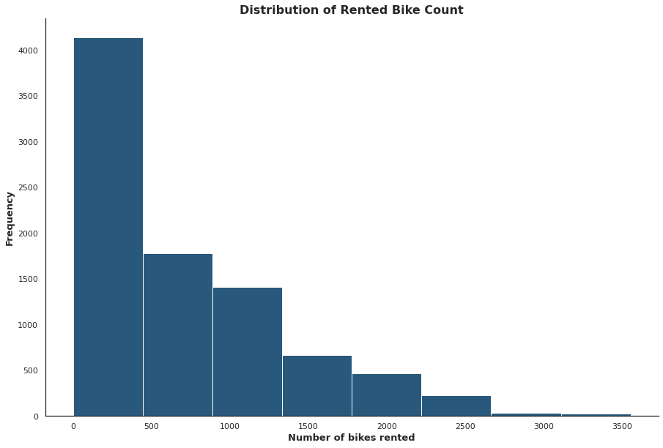
What is the distribution of rented bike counts in our dataset?
The Rented Bike Count variable is highly positively skewed. It measures 1.15 for skewness in the positive direction.
It is fairly expected that the distribution of the target variable will be somewhat like it is i.e. a lot of volume for the smaller numbers and the volume keeps on decreasing as and when we move towards higher numbers.

Slide 8
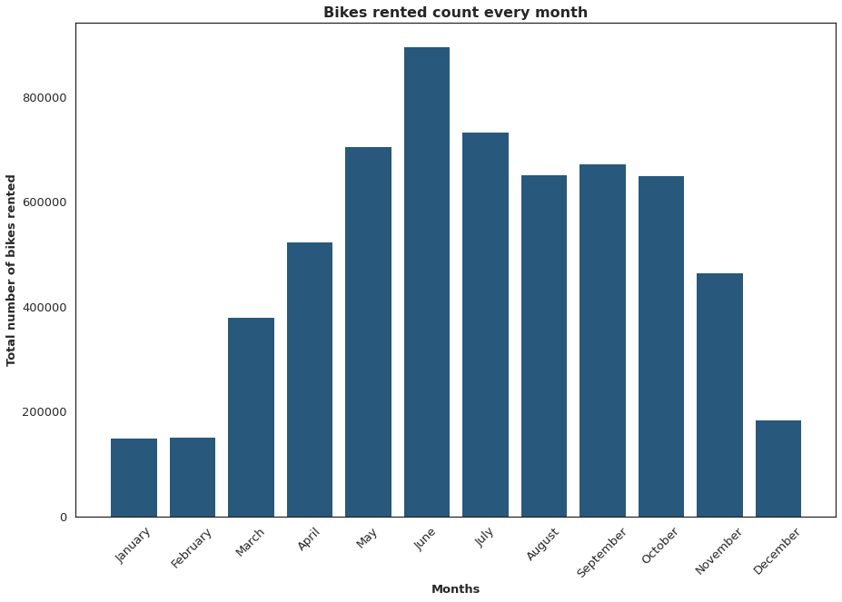
What is the distribution of rented bike counts over months?
We can see that the months in the middle of the year have high bike rentals whereas they are far lesser at the beginning and at the end of the year.
June has the highest bike rentals of all the months.

Slide 9
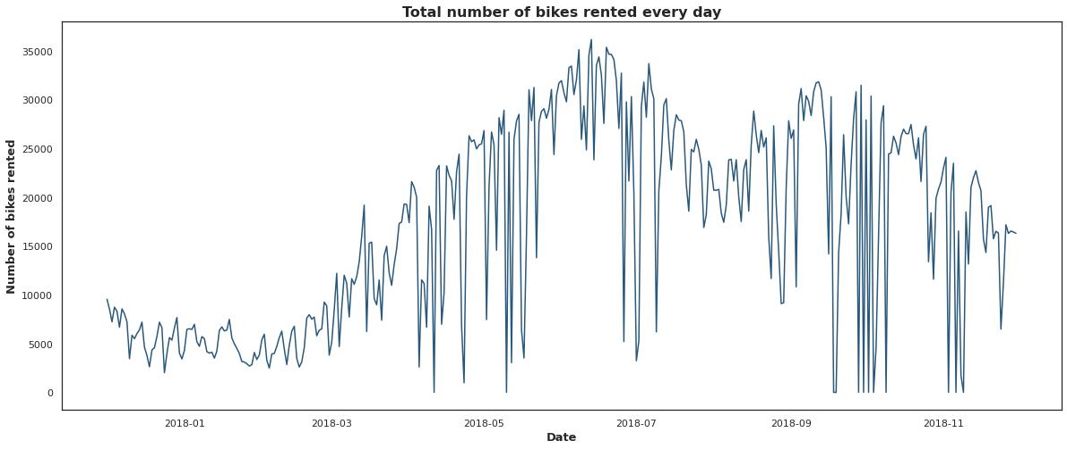
What is the distribution of rented bike counts over days?
It looks like the first two months saw a bit of dip in the number of bikes rented before we saw a consistent growth which peaked in the month of June before the drop until August. Since August, there was again a growth until October after which it started going down again.
Also, the months of April, May, July, September, October and November experienced inconsistency in the number of the bikes rented on a day-to-day basis when compared with the rest of the months.
Knowing it explains which months experience more inconsistency and which doesn't and which ones have more demands and which don't. All these help get more information on the requirements of users.

Slide 10
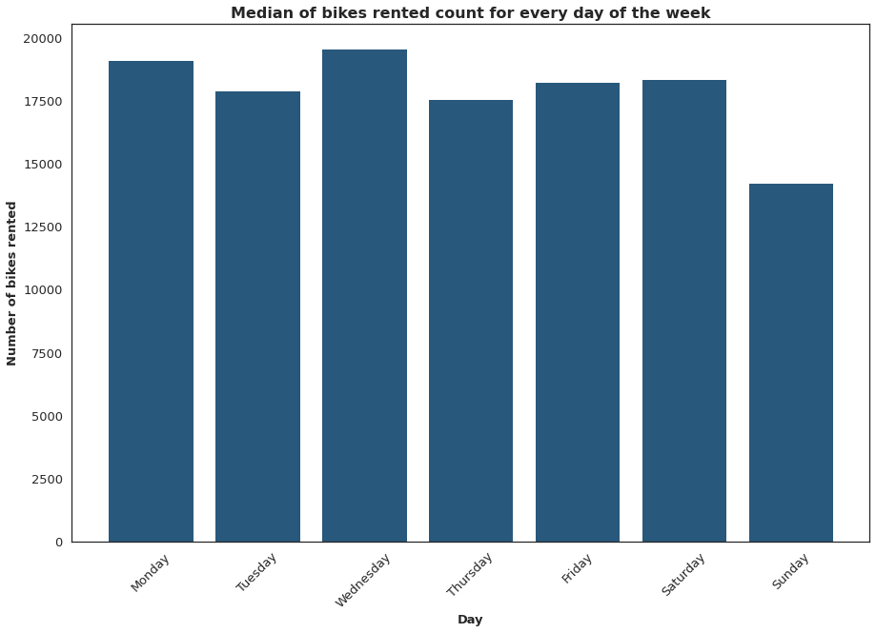
What is the distribution of average rented bike count over days of the week?
Mondays and Wednesdays are the busiest whereas Sunday has the least requirement.
Saturdays are weekends and we expected a drop in the number for Saturdays when compared with Fridays.
However, it wasn't the case. It did drop for Sundays though.

Slide 11
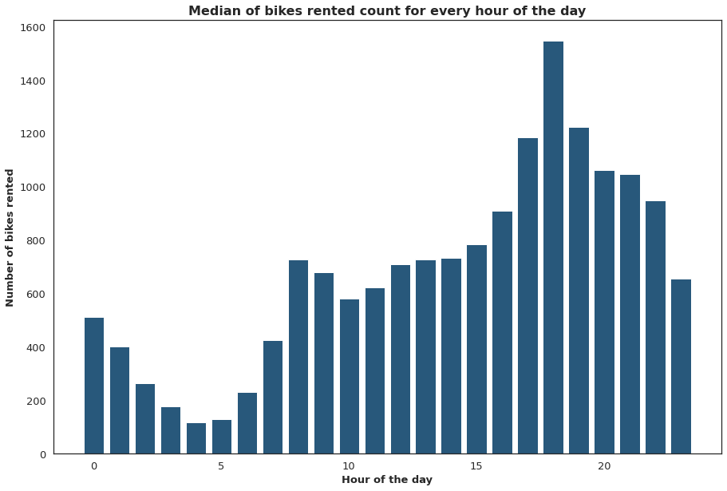
What is the distribution of average rented bike count for every day of the week?
The early morning hours have the lowest demands.
However, after 07:00 hour, the demand grows and stays the same until 15:00 hour.
Post 15:00, the demand grows at a rapid rate and see some of the busiest hours (16:00-22:00).

Slide 12
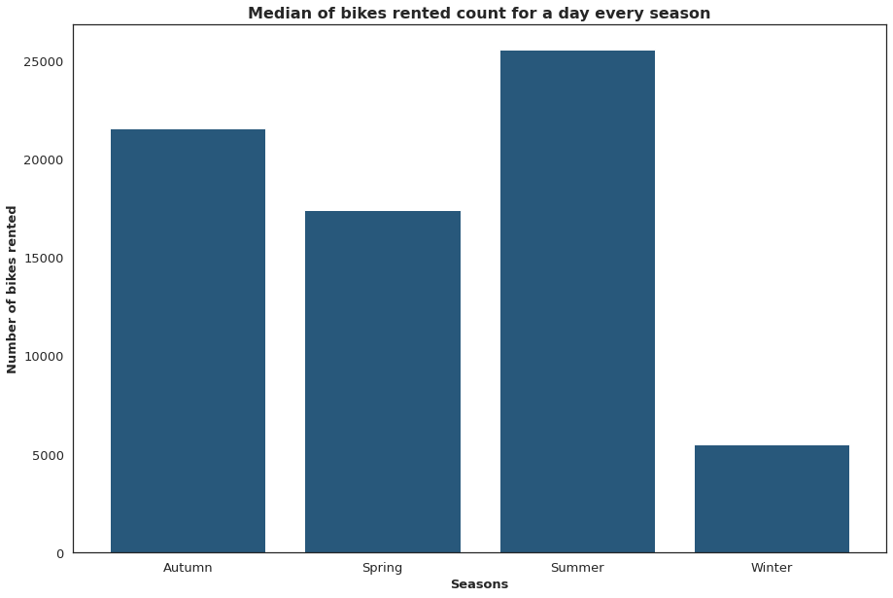
What is the median of rented bike count per day every season?
Winter starts from December and goes on till February. Then comes the season of Spring. It is spread from the month of March till May. After Spring is the season of Summer.
Summer is between the months of June and August. Finally, the months of September, October and November have the season of Autumn.
Winter has very low requirements of bike sharing. Whereas, Summer has the highest.

Slide 13
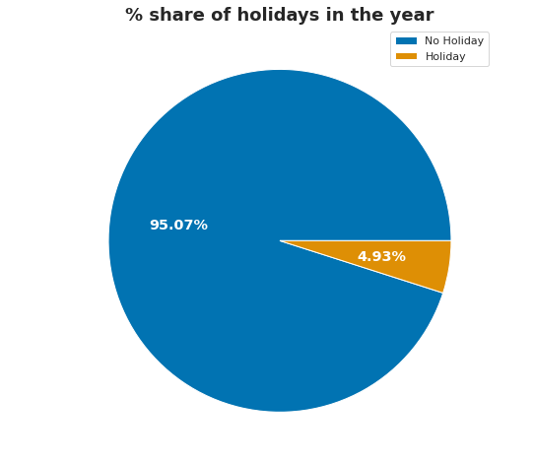
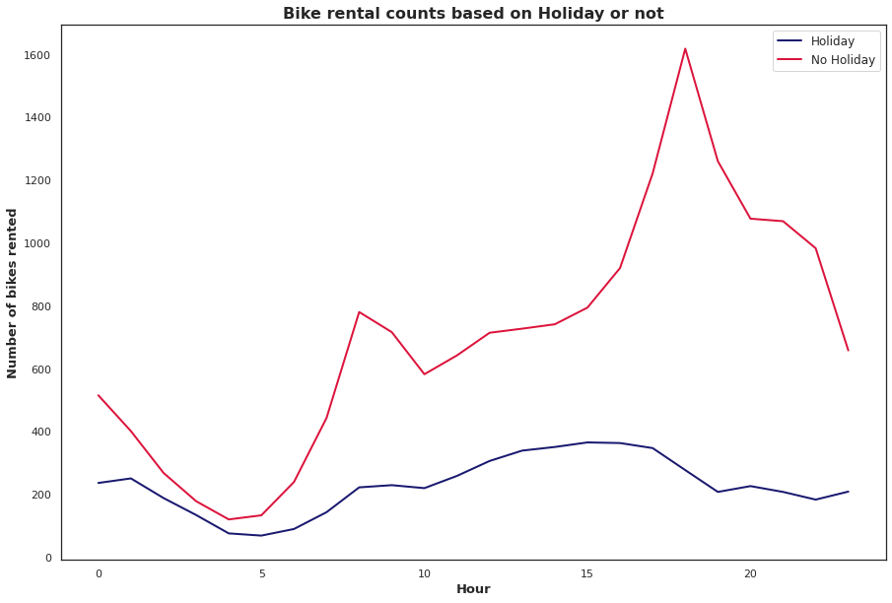
How does bike rental counts vary based on holiday?
The dataset has 365 days of data, a year. And from the 365 days, only 18 days (4.93%) were holidays.
When it is a holiday, the bike rentals are very low, even during the supposed peak hours of the day during evening and night.

Slide 14
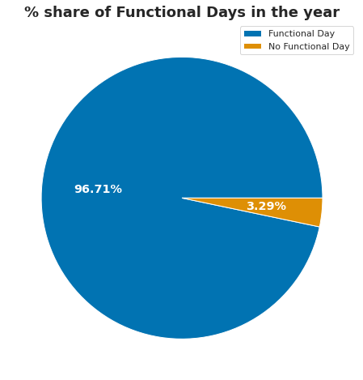
How many days were functional?
There were 353 functional days (96.71%) in the 365 days of the dataset. Functional days are when the bike sharing and rental options are available.

Slide 15
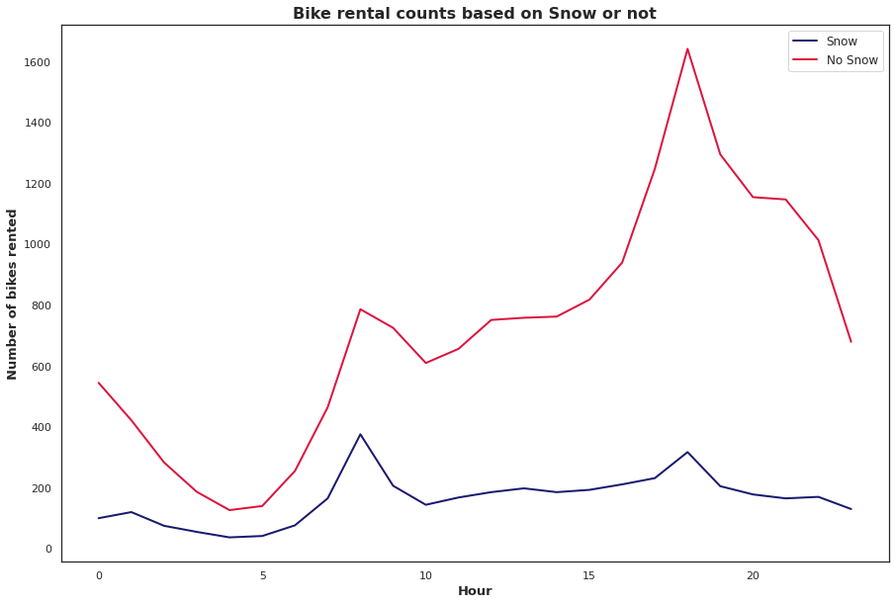
How much does snowfall affect the rental of bikes?
The patterns of the bike rental counts when it snows is somewhat similar in shape and lower in volume to the one when it doesn't, without the massive growth experienced post noon.
When it snows, the bike rentals stay somewhat close to 200 every hour.

Slide 16
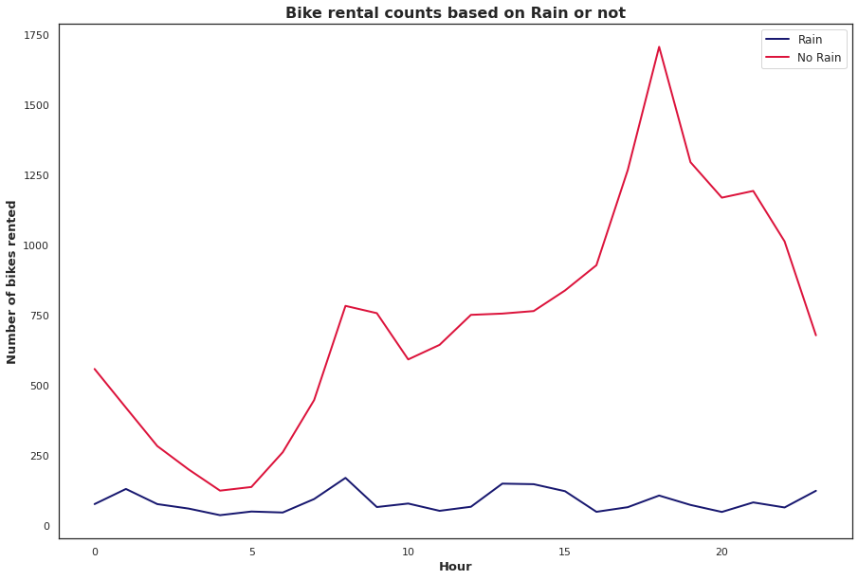
How much does rainfall affect the rental of bikes?
Rainfall seems to have the most say on the bike rental counts. When it rains, the bike rental counts stay below 200 throughout the 24-hour cycle.

Slide 17
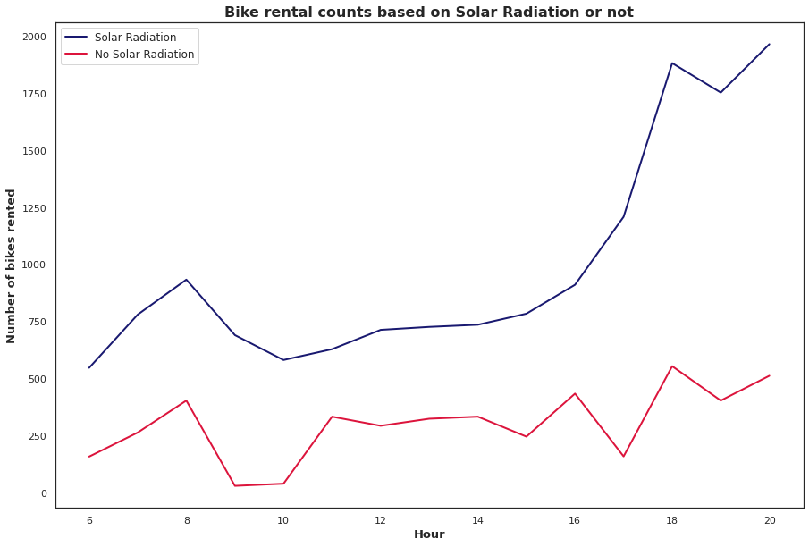
How much does solar radiation affects the bike rental counts?
Solar Radiation is experienced only post 06:00 hour and before 20:00 hour. And it increases the bike rental counts to almost triple the numbers expected during a non-solar radiation timeline.

Slide 18
Feature Engineering & Data Pre-Processing

Slide 19
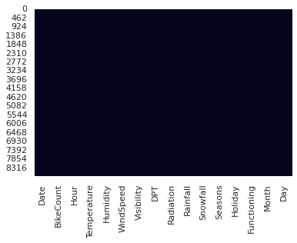
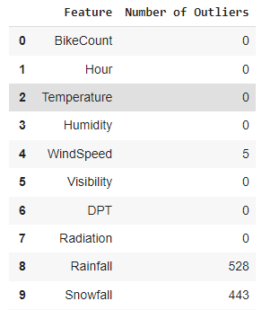
Dealing with missing values and outliers
There were no missing values to work with in the dataset.
On the contrary, there are outliers in the dataset for two variables. However, these outliers are important as they basically indicate days with rainfalls and snowfalls and hence, they should not be changed or deleted as we will start losing meaningful information from the dataset.

Slide 20
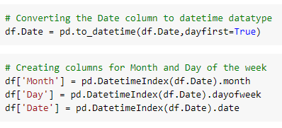
Feature Manipulation
We have converted the Date column into Datetime data type from object data type.
We have also added two new columns by extracting the information from the Date column.
The columns included are Month and Day to depict the month and the day of the week.

Slide 21
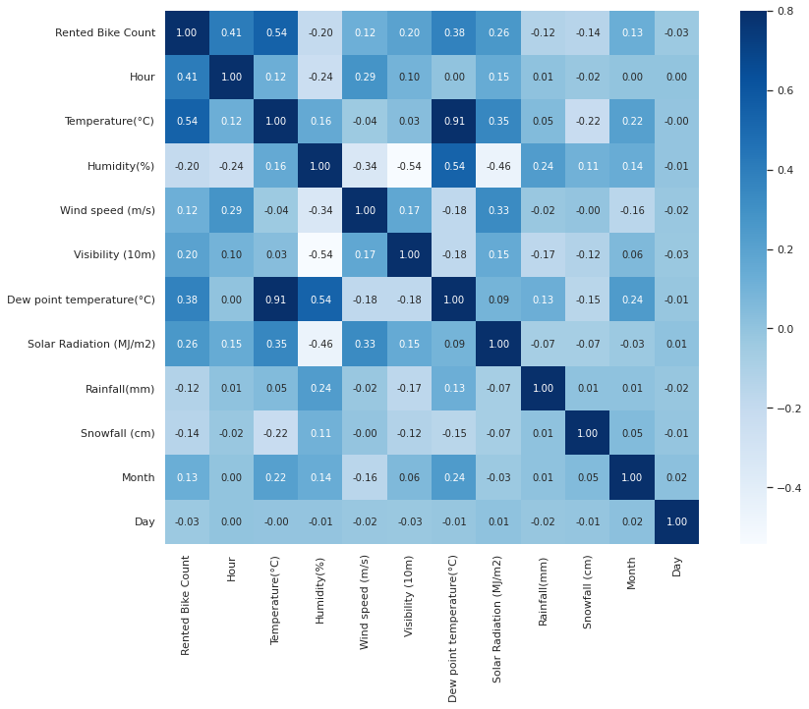
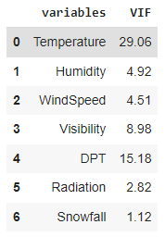
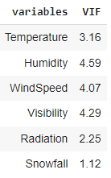
Feature Selection
DPT i.e. Dew point temperature is highly correlated with temperature, unsurprisingly. And so, VIF has a very high value for it and we decided to remove it. That helped us bring the VIF values for the rest of the numerical columns down under 5.
There are still columns like Humidity and Visibility that have variance in excess of 300% than what it would generally have if the variables weren't correlated. In an ideal world, we would want to bring these down to as low as possible. However, the general practice is to go ahead if the VIF values are lesser than 5. And so, we have decided to keep those variables.

Slide 22
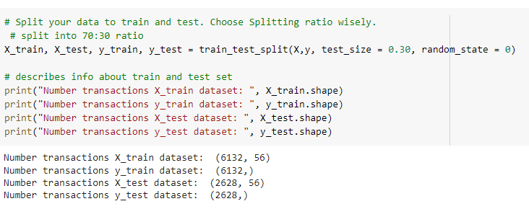
Data Splitting
We have used the 70-30 split for the dataset to ensure that there are enough values in the train set.

Slide 23
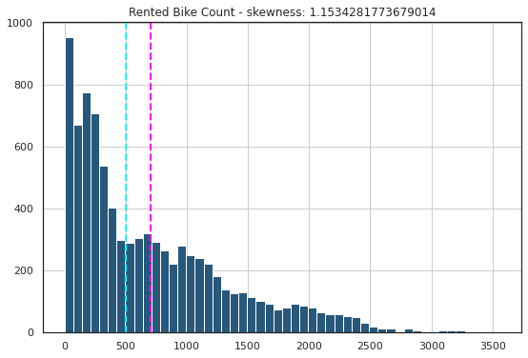
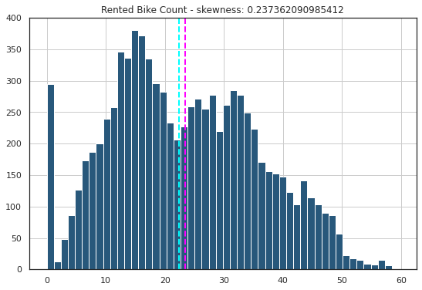
Data Transformation & Scaling
We have combined the process of transformation and scaling. For transformation, since we figured out that the distribution of the target variable isn't gaussian-like distribution, we applied the square-root transformation on it to make it more normal like and bring the skewness value down from a highly positively skewed number to a moderately positively skewed number.
For scaling, we have applied the z-score to standardise the values which makes the mean 0 and standard deviation 1 for the variables.

Slide 24
Model Building

Slide 25
Setting the metric right!
Before we begin the model building phase, we would like to set a single metric that we will be using to judge our models. And that metric is going to be the R2 score.
R2 scores are basically how much variance of the target variable the models are able to explain. So, obviously the higher the R2 value, the better the model.
The formula for R2 score is:
R2 = 1 - (Sum of squares of residuals/Total sum of squared errors)
Sum of squared of residuals = (y_pred - y_test)**2
Total sum of squared errors = (y - y_mean)**2

Slide 26
More on the metrics:
The mean squared error (MSE) tells you how close a regression line is to a set of points. It does this by taking the distances from the points to the regression line (these distances are the “errors”) and squaring them. It’s called the mean squared error as you’re finding the average of a set of errors. The lower the MSE, the better the forecast.
MSE formula = (1/n) * Σ(actual – forecast)**2
Where:
n = number of items,
Σ = summation notation,
Actual = original or observed y-value,
Forecast = y-value from regression.
Root Mean Square Error (RMSE) is the standard deviation of the residuals (prediction errors).
Mean Absolute Error (MAE) are metrics used to evaluate a Regression Model. ... Here, errors are the differences between the predicted values (values predicted by our regression model) and the actual values of a variable.
R-squared (R2) is a statistical measure that represents the proportion of the variance for a dependent variable that's explained by an independent variable or variables in a regression model.
Formula for R-Squared
R2 =1− Total Variation/Unexplained Variation​
Adjusted R-squared is a modified version of R-squared that has been adjusted for the number of predictors in the model.​

Slide 27
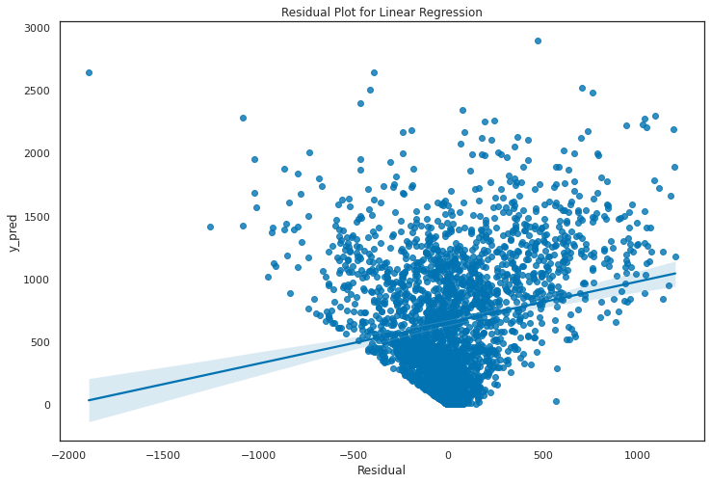
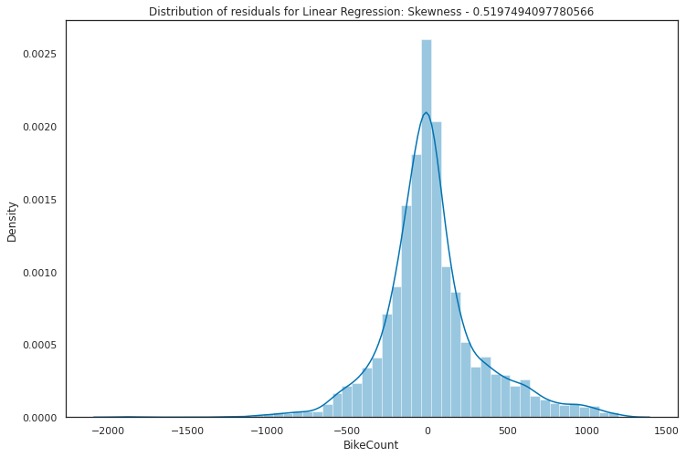
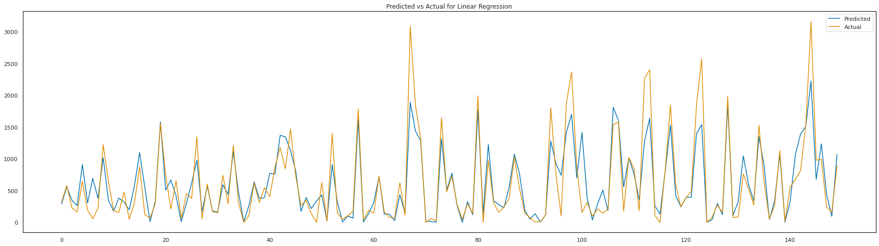
Linear Regression
The linear regression baseline model does well to cover a bit more than 75% of the variance in the target variable. It doesn't overfit or underfit as we have seen from the R2 values for the train and test sets.
It gives a lot of importance to the categorical features. Hours, Seasons, Month, Functional Day and Holiday have a lot more say than the numerical features like Temperature, Humidity and Visibility.

Slide 28



Lasso Regression
The Lasso regression model doesn't significantly do much better or worse than the baseline regression model. Even when we used the Hyperparameter tuning methods, the performance could not be bettered. So, they also covered approximately 75% of the target variable’s variance.
As for the feature important aspect of the model - temperature and some of the hour variables have the most say while a few of them have been eliminated from the model through its feature selection method.

Slide 29

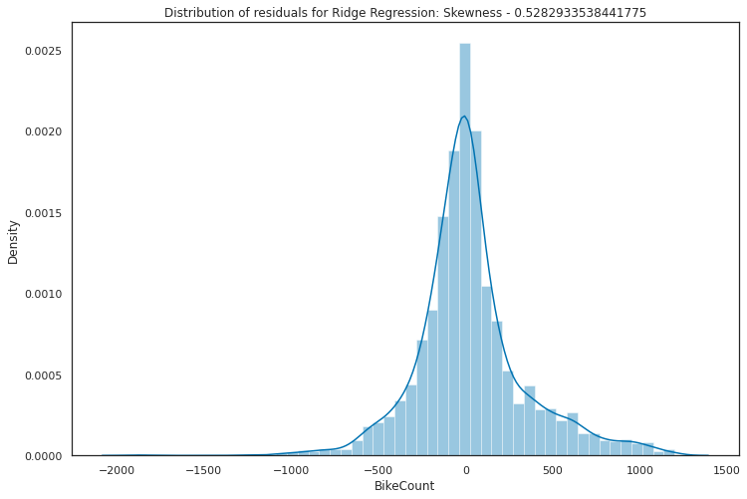

Ridge Regression
The Ridge Regression model is no better than the other two models as it also fails to cover more than 75% of the variance.
With or without hyperparameter tuning, the r2 score doesn’t really change much.

Slide 30

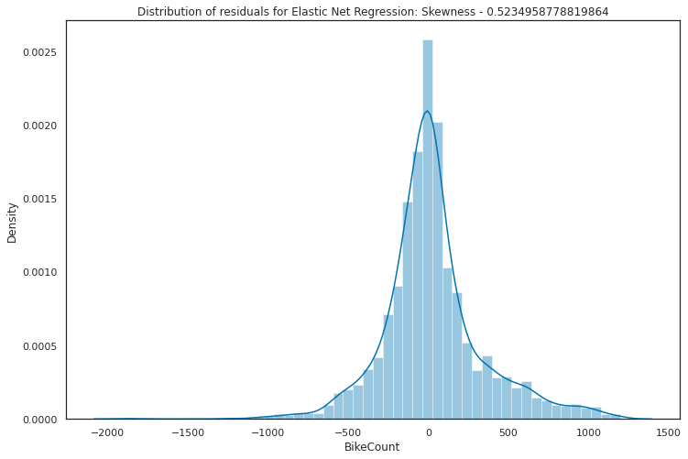

Elastic Net Regression
Elastic Net Regression is a combination of the Lasso and the Ridge Regressions. It is meant to bring the best of both the worlds.
However, in our case, it is not giving us the desired results and our search for a model with better r2 score continues.

Slide 31
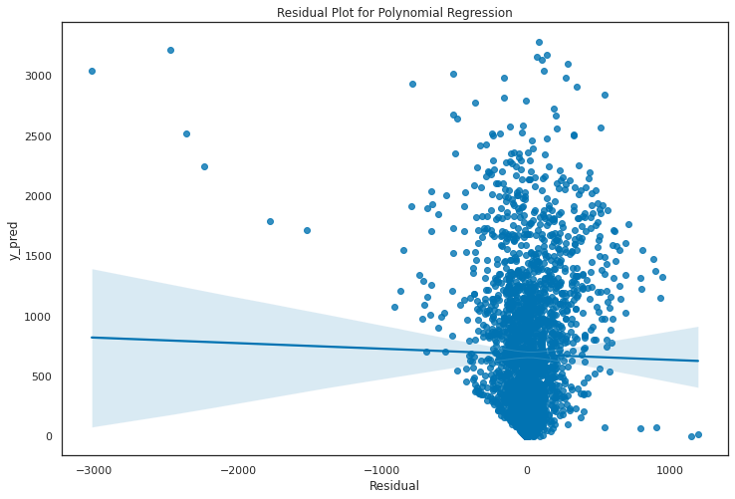
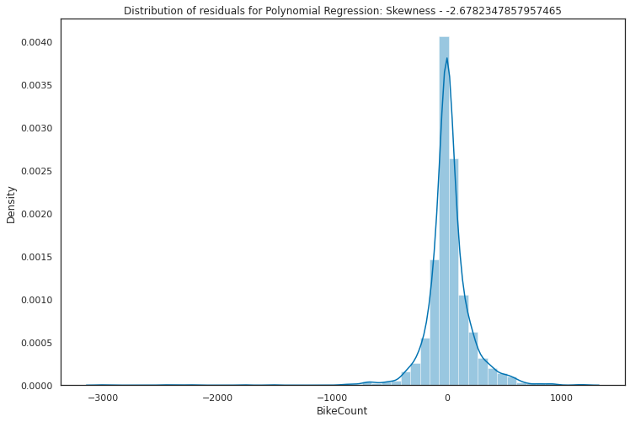
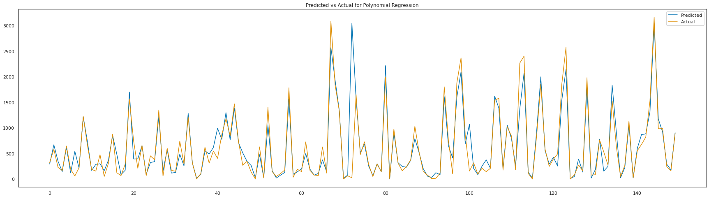
Polynomial Regression
Finally some breakthrough for us as Polynomial Regression gives us the variance coverage of an astonishing 89%.
For the uninitiated, Polynomial Regression is Linear Regression model build on top of Polynomial features with degrees more than 1.
Here, however, we have had to deal with a major issue. Our model has more than half of the number of datapoints it has in the test set. It is obviously not an ideal scenario and such models are hard to trust with for the best performances. Hence, we will keep looking for better performance now from tree-based regressor models.

Slide 32
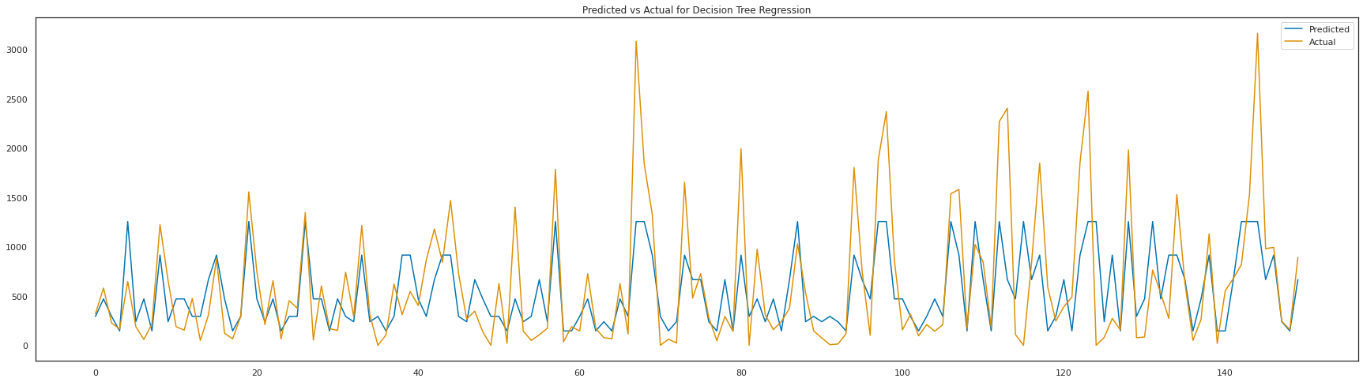
Decision Tree Regressor
Our first tree-based regressor is perhaps as bad as it could have gotten. We have an r2 score of just 0.357 and it definitely the worst model we will have of all the ones we try.

Slide 33
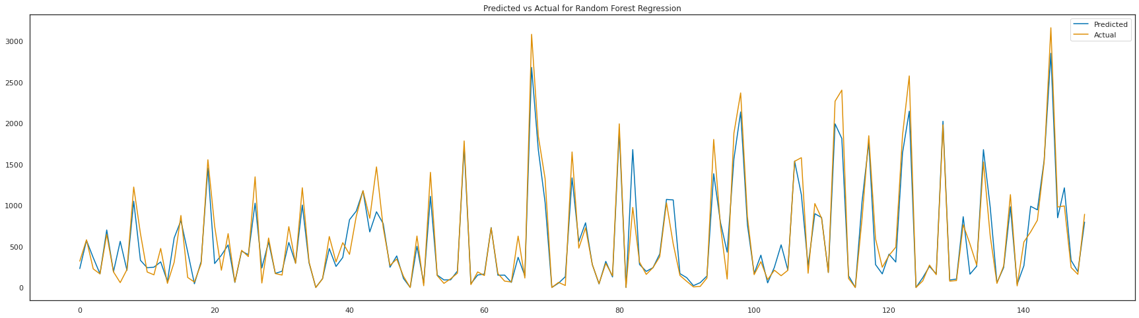
Random Forest Regressor
Random Forest Regressor is one of the two ensemble method based algorithms I have decided to try. And the result for the Random Forest Model is very inspiring. We have gotten over the 92% mark for variance coverage of the training set and 87% for variance coverage of the test set.
This means that neither the model is overfitting, nor does it require 1500+ high degree independent variables for better predictive powers.

Slide 34
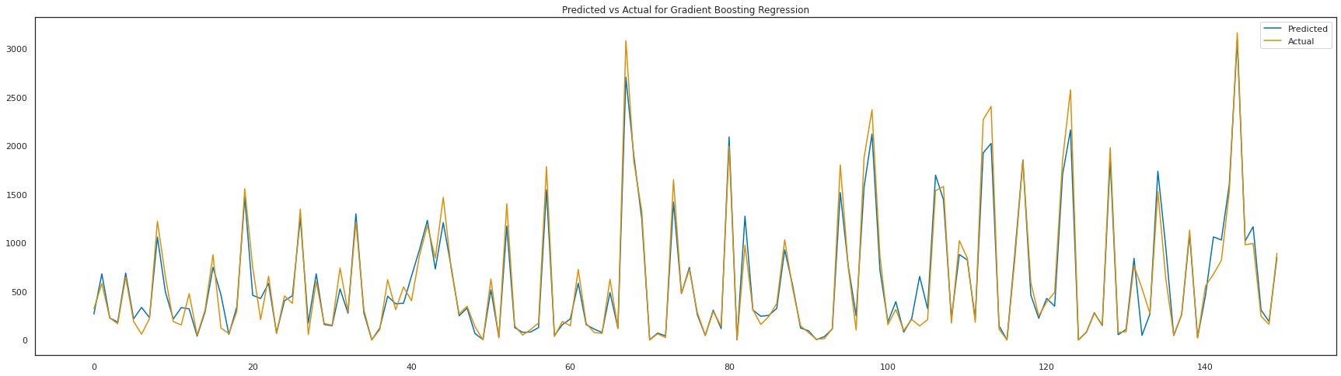
Gradient Boosting Regressor
The final model we prepared turns out to be our best model of the project with an r2 score of 0.93.
The Gradient Boosting Model has helped us cover and explain 93% of the variance of the target variable of the dataset, Rented Bike Count. And the model is overfitting as there a gap of only about 5% between the training set and test set prediction scores.
As for the feature importances for the model, we have Temperature, Humidity and Functioning Day as the three most important features for the Gradient Boosting Model.

Slide 35
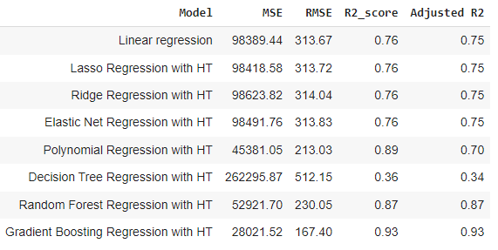
Model Comparison:

Slide 36
Conclusion

Slide 37
Conclusion
The Rented Bike Count variable is highly positively skewed. It measures 1.15 for skewness in the positive direction. It is fairly expected that the distribution of the target variable will be somewhat like it is i.e. a lot of volume for the smaller numbers and the volume keeps on decreasing as and when we move towards higher numbers.
The months in the middle of the year have high bike rentals whereas they are far lesser at the beginning and at the end of the year. June has the highest bike rentals of all the months.
The first two months saw a bit of dip in the number of bikes rented before we saw a consistent growth which peaked in the month of June before the drop until August. Since August, there was again a growth until October after which it started going down again.
Also, the months of April, May, July, September, October and November experienced inconsistency in the number of the bikes rented on a day-to-day basis when compared with the rest of the months.
Mondays and Wednesdays are the busiest whereas Sunday has the least requirement.
The early morning hours have the lowest demands. However, after 07:00 hour, the demand grows and stays the same until 15:00 hour. Post 15:00, the demand grows at a rapid rate and see some of the busiest hours (16:00-22:00).
Winter starts from December and goes on till February. Then comes the season of Spring. It is spread from the month of March till May. After Spring is the season of Summer. Summer is between the months of June and August. Finally, the months of September, October and November have the season of Autumn. Winter has very low requirements of bike sharing. Whereas, Summer has the highest.
The dataset has 365 days of data, a year. And from the 365 days, only 18 days (4.93%) were holidays.

Slide 38
Conclusion
When it is a holiday, the bike rentals are very low, even during the supposed peak hours of the day during evening and night.
There were 353 functional days (96.71%) in the 365 days of the dataset. Functional days are when the bike sharing and rental options are available.
The patterns of the bike rental counts when it snows is somewhat similar in shape and lower in volume to the one when it doesn't, without the massive growth experienced post noon. When it snows, the bike rentals stay somewhat close to 200 every hour.
Rainfall seems to have the most say on the bike rental counts. When it rains, the bike rental counts stay below 200 throughout the 24-hour cycle.
Solar Radiation is experienced only post 06:00 hour and before 20:00 hour. And it increases the bike rental counts to almost triple the numbers expected during a non-solar radiation timeline.
A hyperparameter-tuned Gradient Boosting Regressor Algorithm works best for us as it has less than 5% difference between the training and test set predictive r2 scores and covers 93% of the total variance in the target variable. Features like Temperature, Humidity and some of the Hours had the highest importance of all.
Due to the presence of a number of important categorical variables, linear models fail to do as well, except for when built on top of a high-degree polynomial features set. However, it is not advisable as the number of features are too high and the model thus is not a trustworthy one.
Nowhere we encountered the problem of overfitting.

Slide 39
What could have been better?

Slide 40
What could have been better?
Even though we have tried to the best of our abilities, there is always a room for improvements.
We believe that the outliers could have been handled better, perhaps in a more elaborate technique. We could taken the usual boundaries for outliers instead of the extreme ones and tried our way with turning columns like rainfall and snowfall to see if that would have better the predictive power of the model.
That brings us to another possible place for improvement: feature engineering. As said earlier, we could have tried feature engineering on several columns that we didn’t and we could have even used some of the more advanced techniques which we didn’t.
Lastly, we could have tried to understand the relationships between the independent variables and target variable through hypothesis testing.

Slide 41
Thank You

